Slide 1
Time of Magic Presentation

Slide 2
Why Look at Disney Wait Times Data
Disney World is an extremely popular tourist destination, with Magic Kingdom being the most well-known parks on the campus.
The 50th Anniversary celebration will be on October 1st.
We chose to look at DisneyWorld data regarding wait times to draw correlations between wait times and specific conditions such as average temperature and local schools in session.

Slide 3
What We Seek To Answer
What are the metrics that impact ride wait times?
2. What times of the year can higher ride wait times be expected?

Slide 4
Description of Data Sources
Ride specific data, weather data, and school data are gathered from TouringPlans.com. TouringPlans.com is a trip planning tool that makes their source data publicly available.
7 Dwarfs Train
Big Thunder Mountain
Haunted Mansion
It’s A Small World
Peter Pan’s Flight
Pirates of the Caribbean
Space Mountain
Splash Mountain
Resources: https://touringplans.com/walt-disney-world/crowd-calendar#DataSets.

Slide 5
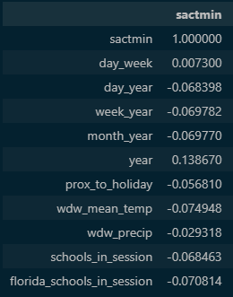
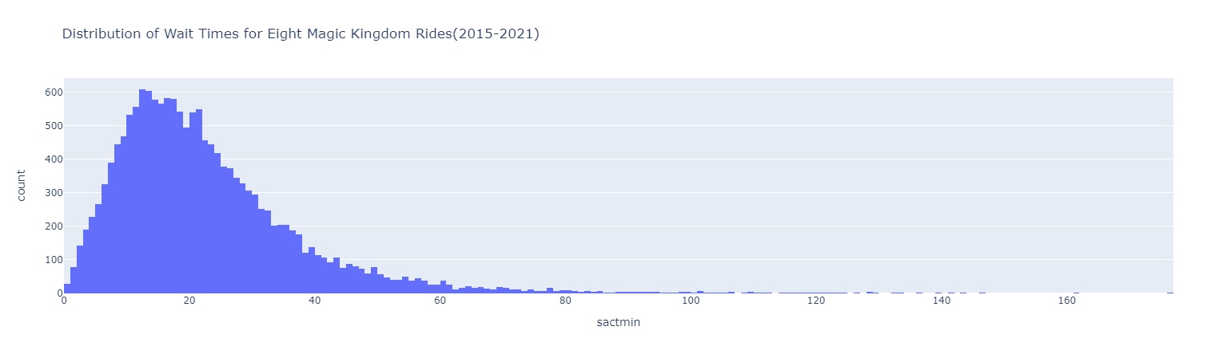
Data Exploration Summary
Merged 8 ride files and features metadata into single dataframe by date.
Selected the “actual wait time” as our primary target variable.
Dropped null or improbable values as incorrect data.
Chose temperature, precipitation, schools in session, and proximity to holidays as factors to investigate.

Slide 6
Data Analysis Summary
We chose a Balanced Random Forest Classifier model to determine if ride wait time data could be accurately predicted by the chosen features. We also aimed to identify the feature importance hierarchy.
The average temperature for the day accounted for 14.5% of the weight dependency.
The day of the year accounted for 13.4%.
The percentage of schools in session across the US accounted for 11.9%.

Slide 7
Dashboard Blueprint
Interactive Elements:
Ruling Filters
Dependent Graphs
Dependent Legend
Tools
JavaScript
Flask app
MongoDB

